Slide 1
Copper Hydride Catalyzed Hydroamination of
Alkenes and Alkynes
Reporter: Pengfei Yuan
Supervisor: Prof. Yong Huang
2016-06-22

Slide 2
Contents
1. Introduction
2. Study of copper(I) Hydride complexes, hydroxylamine
esters and related reactions
3. Copper(I) hydride-catalyzed hydroamination:
scope, and mechanistic insight
Outlook
5. Acknowledgement

Slide 3
Contents
1. Introduction
2. Study of copper(I) Hydride complexes, hydroxylamine
esters and related reactions
3. Copper(I) hydride-catalyzed hydroamination:
scope, and mechanistic insight
Outlook
5. Acknowledgement

Slide 4
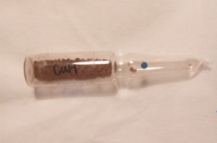
Copper hydride
Source of hydride
Source of copper
Red solid
Air sensitive

Slide 5
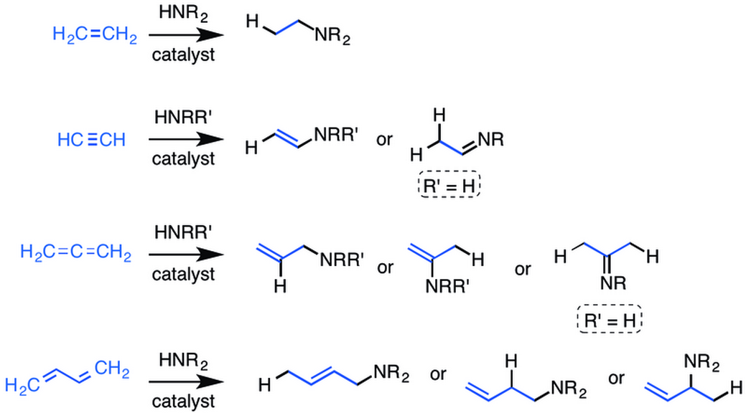
Hydroamination

Slide 6
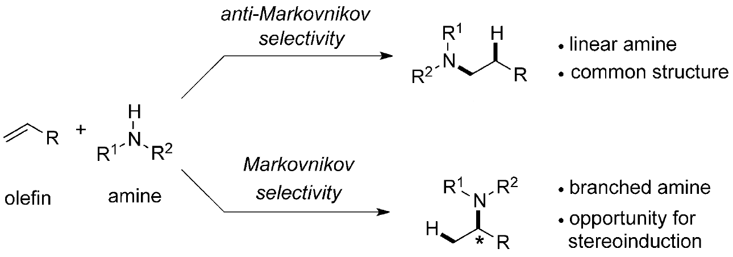
Two possible regiochemical outcomes
S. L. Buchwald, Angew. Chem. Int. Ed. 2016, 55, 48.

Slide 7
Contents
1. Introduction
2. Study of copper(I) Hydride complexes, hydroxylamine
esters and related reactions
3. Copper(I) hydride-catalyzed hydroamination:
scope, and mechanistic insight
Outlook
5. Acknowledgement

Slide 8
Application of copper(I) hydride complexes
1,4-reduction
1,2-reduction
high regioselective
absolute stereocontrol
create SP³ center
hydroalkylation
hydroamination

Slide 9
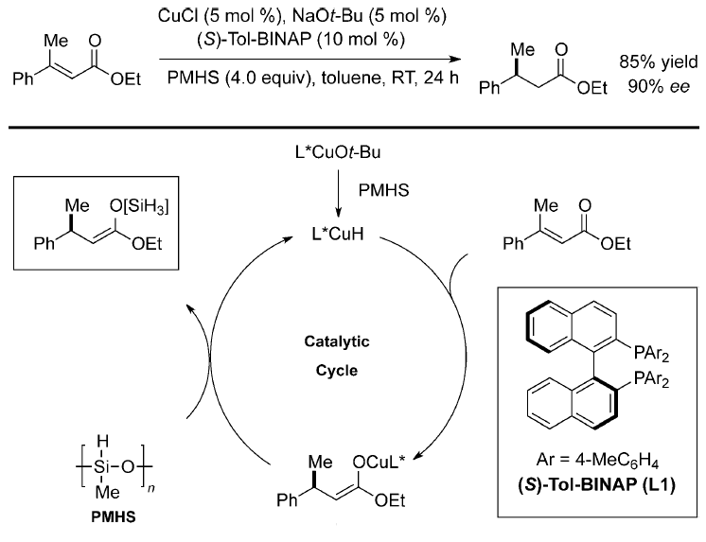
The first highly enantioselective CuH chemistry
S. L. Buchwald, J. Am. Chem. Soc. 1999, 121, 9473.

Slide 10
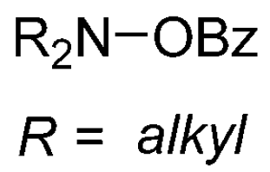
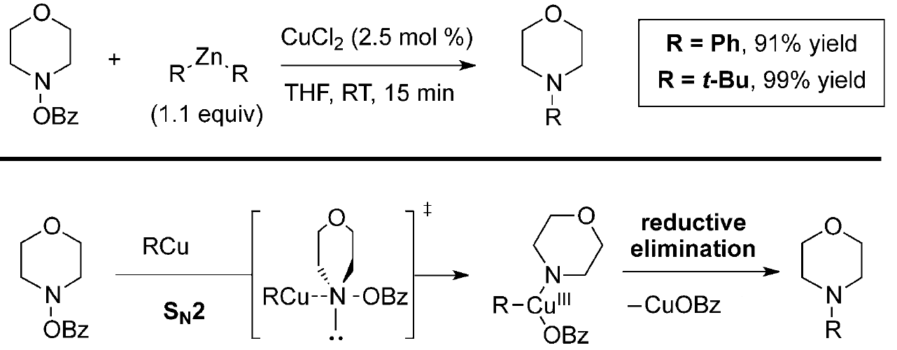
Aminating reagent
J. S. Johnson, J. Am. Chem. Soc. 2004, 126, 5680.

Slide 11
Contents
1. Introduction
2. Study of copper(I) Hydride complexes, hydroxylamine
esters and related reactions
3. Copper(I) hydride-catalyzed hydroamination:
scope, and mechanistic insight
Outlook
5. Acknowledgement

Slide 12
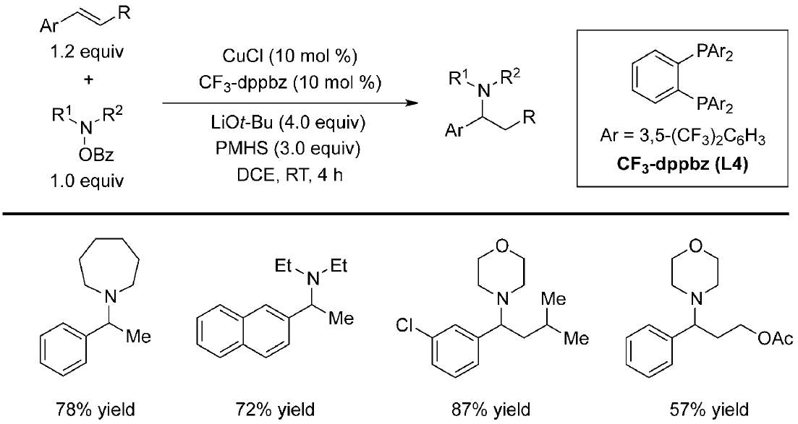
CuH-catalyzed racemic hydroamination of styrene
M. Miura, Angew. Chem. Int. Ed. 2013, 52, 10830.

Slide 13
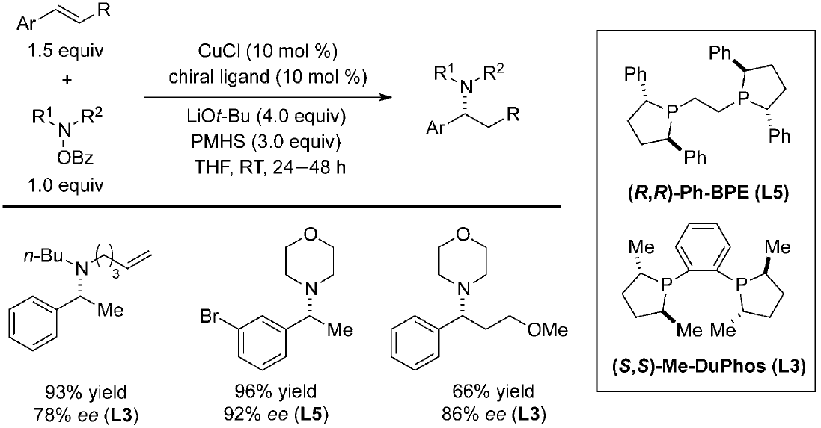
CuH-catalyzed asymmetrical hydroamination of styrene
M. Miura, Angew. Chem. Int. Ed. 2013, 52, 10830.

Slide 14
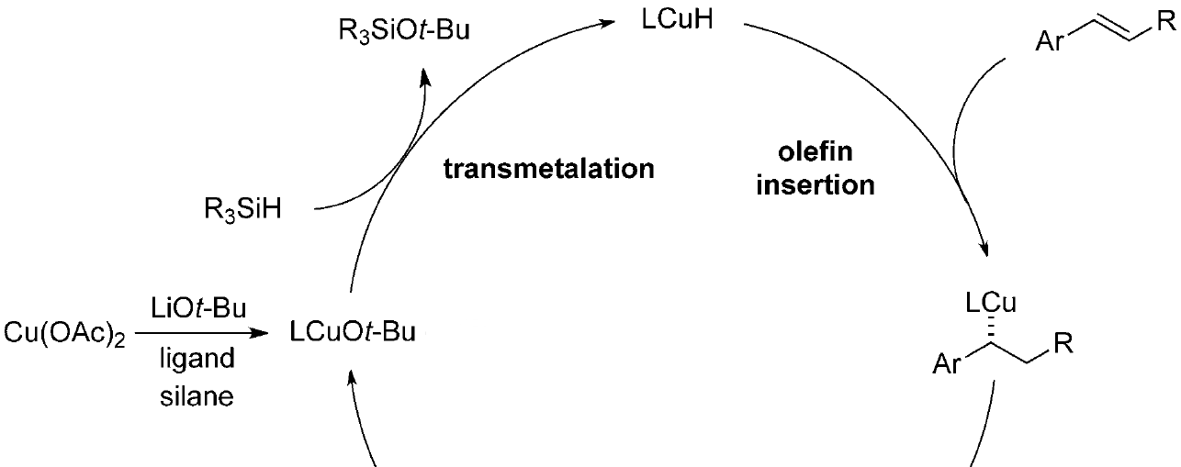
Proposed mechanism for hydroamination of styrene
M. Miura, Angew. Chem. Int. Ed. 2013, 52, 10830.

Slide 15
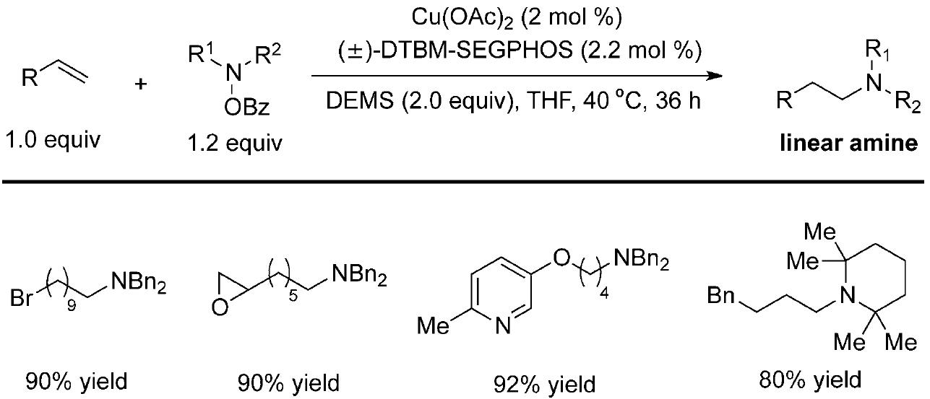
Anti-Markovnikov hydroamination of terminal olefin

Slide 16
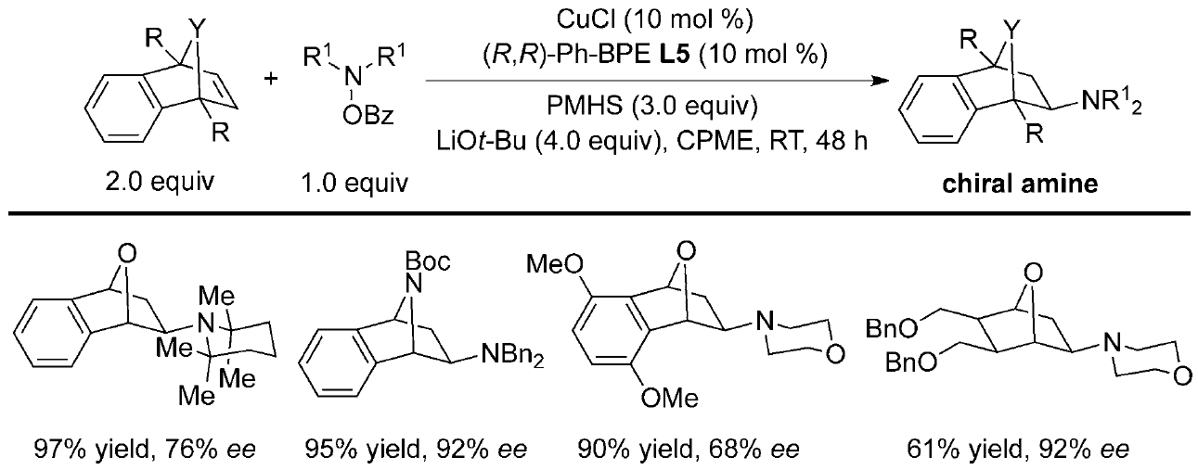
Hydroamination of oxa- and azabicyclic alkene
M. Miura, Org. Lett. 2014, 16,1498.

Slide 17
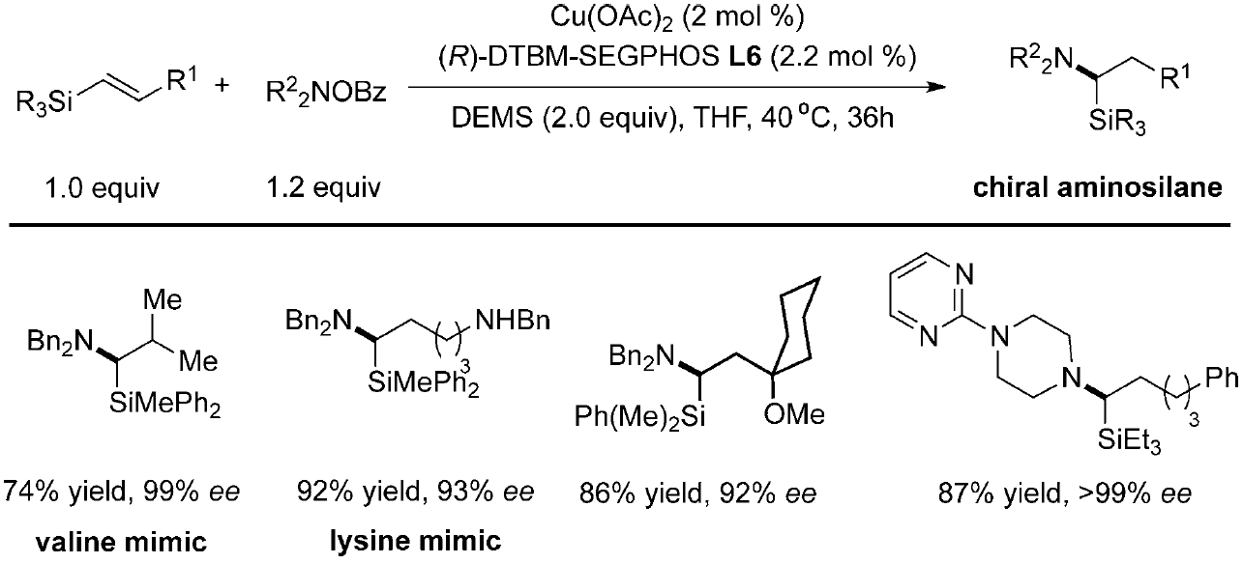
Enantioselective synthesis of α-aminosilane
S. L. Buchwald, Angew. Chem. Int. Ed. 2015, 54, 1638.

Slide 18
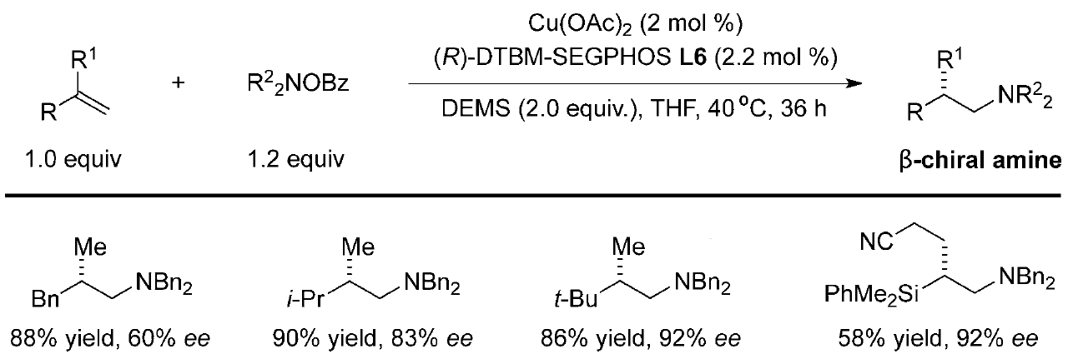
Enantioselective hydroamination of
1,1-disubstituted alkene
S. L. Buchwald, J. Am. Chem. Soc. 2014, 136, 15913.

Slide 19
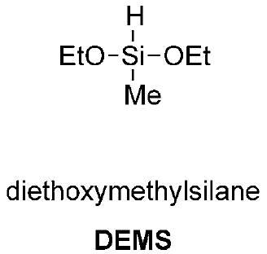
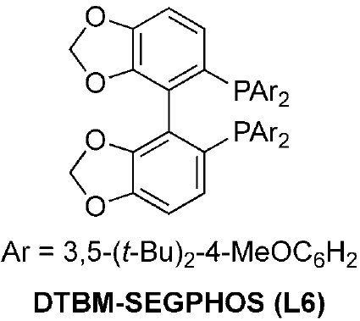
CuH-catalyzed hydroamination of alkyne
S. L. Buchwald, Nat. Chem. 2015, 7, 38.

Slide 20
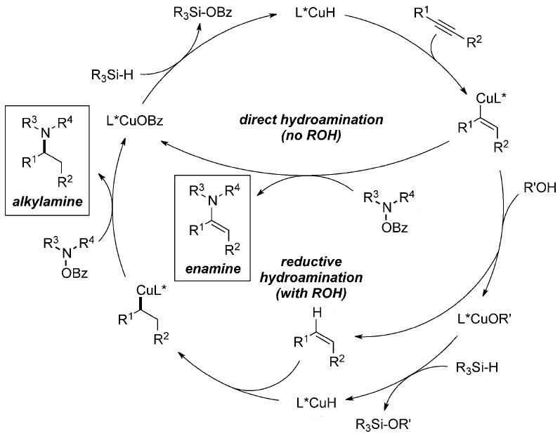
Proposed mechanism for hydroamination of alkyne
S. L. Buchwald, Nat. Chem. 2015, 7, 38.

Slide 21
Mechanism study for hydroamination of alkyne
S. L. Buchwald, Nat. Chem. 2015, 7, 38.

Slide 22
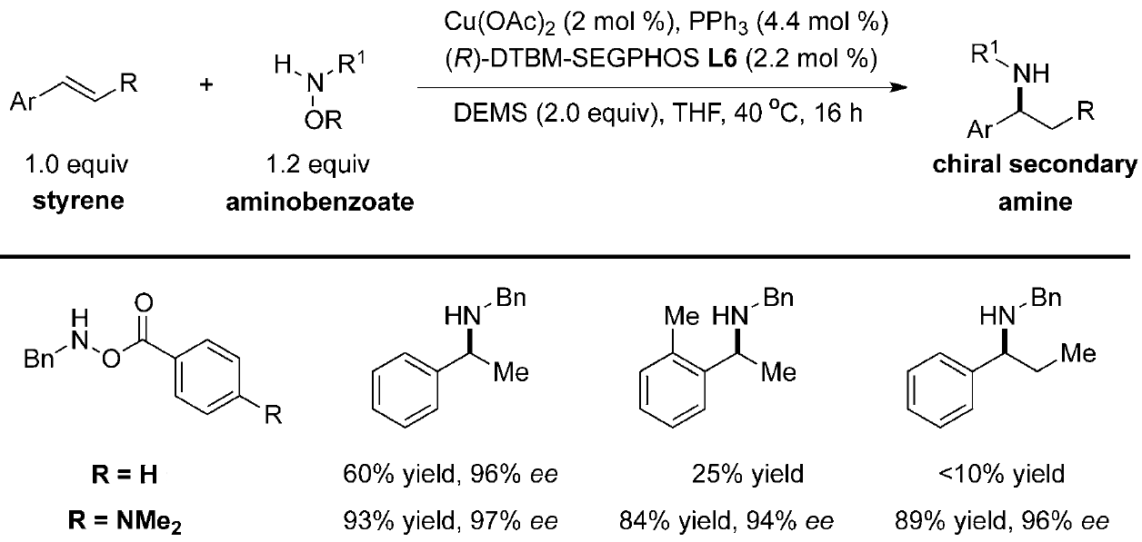
CuH-catalyzed synthesis of chiral secondary amine
S. L. Buchwald, J. Am. Chem. Soc. 2015, 137, 9716.

Slide 23
Competition experiments
S. L. Buchwald, J. Am. Chem. Soc. 2015, 137, 9716.

Slide 24
Hydroamination of unactivated internal olefin
S. L. Buchwald, Science, 2015, 349, 62.

Slide 25
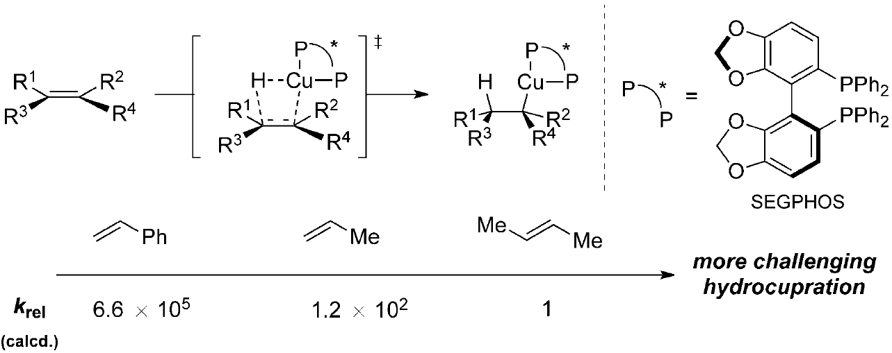
Calculation
S. L. Buchwald, Science, 2015, 349, 62.

Slide 26
Contents
1. Introduction
2. Study of copper(I) Hydride complexes, hydroxylamine
esters and related reactions
3. Copper(I) hydride-catalyzed hydroamination:
scope, and mechanistic insight
Outlook
5. Acknowledgement

Slide 27
Outlook
Amines derived from tri- and tetrasubstituted alkenes;
Utilize electrophilic aminating agents to transfer aromatic amines or ammonia or its equivalents.

Slide 28
Contents
1. Introduction
2. Study of copper(I) Hydride complexes, hydroxylamine
esters and related reactions
3. Copper(I) hydride-catalyzed hydroamination:
scope, and mechanistic insight
Outlook and conclusions
5. Acknowledgement

Slide 29
Acknowledgment
Prof. Huang
Jiean Chen
All members here
Thanks for your attention!

