Slide 1
Literature Report
Review
PKUSZ SCBB
Supervisor: Prof. Yong Huang
Reporter: Miyang Li
Date: 2016-11-28

Slide 2
ACS. Chem. Biol.

Slide 3
Background
Diazo groups are smaller than azido groups;
Diazo groups display a broader range of reactivity;
Diazo groups are found in natural products;

Slide 4
Background

Slide 5
Preparation
compatibility of ancillary functional groups and solubility
because of restrictions in chemical biology study

Slide 6
Preparation
compatibility of ancillary functional groups and solubility
because of restrictions in chemical biology study

Slide 7
Preparation
A general method based on Staudinger
Reaction in chemical biology study
Chemoselectivity is demonstrated in aqueous
solution containing an enzyme, which is not modified
covalently and retained full catalytic activity
Notes:
A High-Yield, Chemoselective, and Mild Synthetic Method Azides react readily with triarylphosphines to form the corresponding iminophophoranes (aza-ylides) with loss of nitrogen. This transformation, originally reported by Staudinger and Meyer,¹ takes place under mild conditions and leads to excellent yields of the aza-ylide products. The initially formed iminophosphorane product can undergo a number of synthetically important reactions with a variety of electrophiles, such as aldehydes and ketones. However, in aqueous medium, it is hydrolyzed to the amine product.^{2,3} The overall reduction of the azide to the amine is believed to take place as shown in Scheme 1

Slide 8
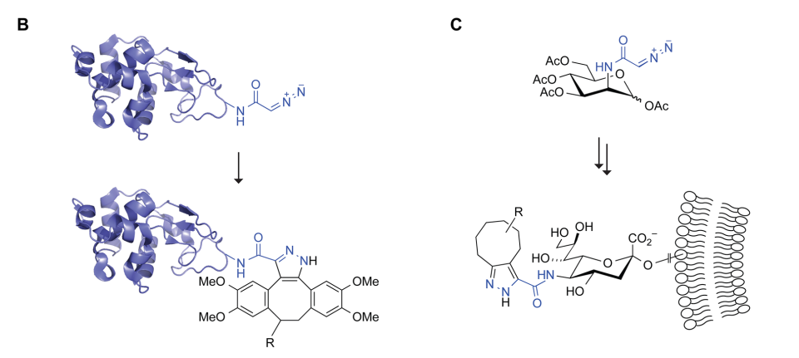
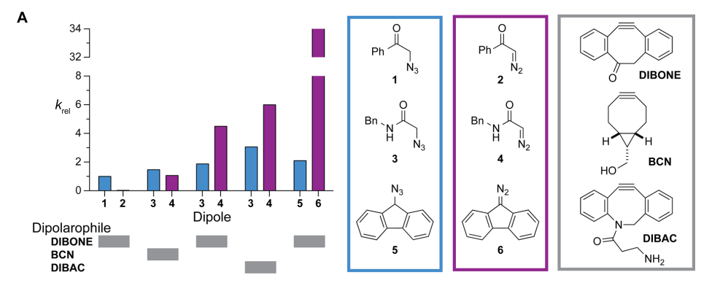
Application
Cycloaddition
1,3-dipolar cycloaddition with alkyne;
Copper-catalyzed azide-alkyne cycloaddition(CuAAC)
Strain-promoted azide-alkyne cycloaddition(SPAAC)
Chemical Biology
Probes
Electron-Rich
Predictable
Tuneable
Relative rate constants of diazo compounds in dipolar cycloadditions with strained alkynes

Slide 9
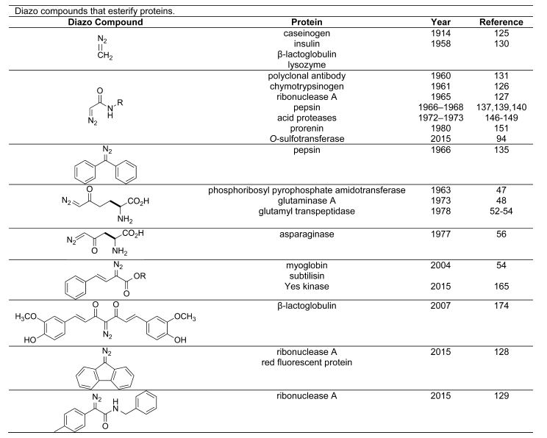
Application
Protein Alkylation

Slide 10
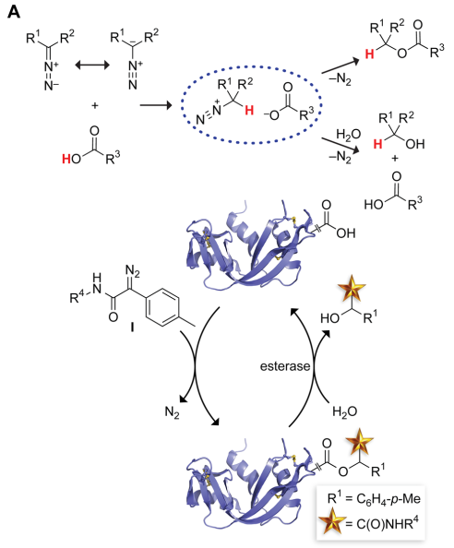
Application
Install a molecule tag
pharmaco-kinetic enhancing moiety;
cell-type-targeting moiety;
cell-penetrating moiety.
Bioreversible Protein Modification

Slide 11
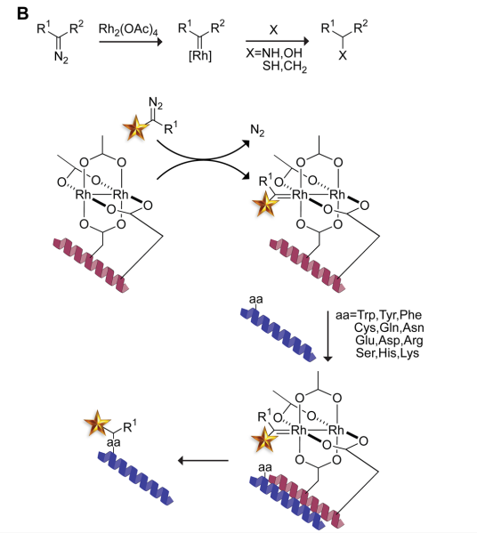
Application
Chiral transition-metal catalyst
The rhodium catalyst is displayed on a peptide, which is designed to bind a second peptide or protein of interest by forming a coiled coil. The catalyst on the metallopeptide is oriented such that the incipient carbenoid is generated proximal to the target residue, focusing its high reactivity and enabling modification of many types of amino acids.
Peptide and Protein Modification
with Carbenoid

Slide 12
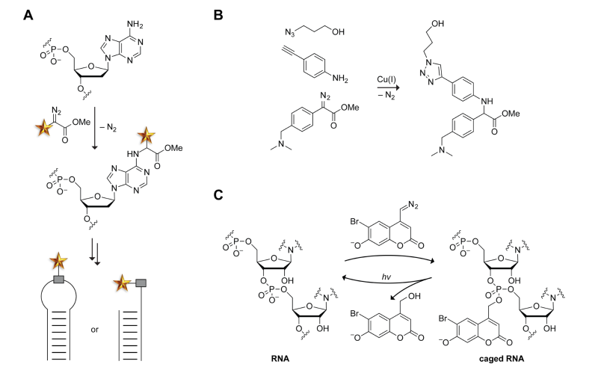
Application
Covalent modification of nucleic acids using diazo compounds.
Representative alkylation of DNA by a diazo compound. Alkylationoccurs on solvent-accessible nucleobases.
(B) One-pot N-H insertion and azide-alkyne cycloaddition with a copper(I) catalyst.
(C)Photoreversible O-alkylation of a phosphoryl group in RNA by a diazo coumarin.

Slide 13
Outlook
Diazo compounds has a long developing history. (120 years)
Facile preparation of stabilized diazo compounds
that are compatible with living systems.
Diazo groups are chemoselective.
Diazo groups have reactivity that is tuneable by
delocalization of the electrons on the a carbon.
Diazo groups have extraordinary versatile reactivity.
broad chemical biology application

Slide 14
Thanks for your attention

