Slide 1

Asymmetric BINOL-Phosphate Derived
Brønsted Acids: Development and Catalytic Mechanism
Reporter: Song Feifei
Supervisor: Prof. Yong Huang
2015.10.12

Slide 2
Outline
Introduction
Catalytic mechanism
Development
Overview of Catalysts
Summary
Looking Forward
Acknowledgment

Slide 3
Introduction
Akiyama, T. et al. Chem. Rev. 2015, 115, 9277.

Slide 4
Introduction
Terada, M. Chem. Commun., 2008, 4097.

Slide 5
Introduction
Rueping, M. et al. Chem. Rev. 2014, 114, 9047.

Slide 6
Catalytic Mechanism
Mono activation
Dual activation
Bifunctional activation
Counterion catalysis
Ligand Behavior in Presence of Metals
Independent relay processes in presence of metals

Slide 7
Mono / Dual Activation
Mono Activation
Dual Activation
Rueping, M. et al. Angew. Chem. Int. Ed. 2011, 50, 6364.; Rueping, M. et al. Chem. Soc. Rev. 2011, 40, 4539.

Slide 8
Bifunctional Activation
Goodman, J. M. et al. J. Org. Chem. 2011, 76, 1775.

Slide 9
Counterion Catalysis
Rueping, M. et al. Chem. Rev. 2014, 114, 9047.

Slide 10
Behavior in Presence of Metals
Ligand or a counterion for the metals
Independent relay processes
Rueping, M. et al. Chem. Eur. J. 2010, 16, 9350.; Alemán, J. et al. Org. Biomol. Chem. 2012, 10, 5001.;
Luo, S. et al. Chem. Commun. 2013, 49, 847.

Slide 11
Development
1971
1978
1992
2004

Slide 12
Background
Jacques, J. et al. Tetrahedron Lett. 1971, 4617.

Slide 13
The Starting Seeds: Phosphinic Acids
Cornforth, J. Proc. R. Soc. London, Ser. B. 1978, 203, 101.

Slide 14
Asymmetric Synthesis Using Chiral
Rhodium Phosphate
McKervey, M. A. et al. Tetrahedron Lett. 1992, 33, 5983.

Slide 15
Mannich-Type Reaction by Akiyama
Akiyama, T. et al. Angew. Chem. Int. Ed. 2004, 43, 1566.; Akiyama, T. et al. J. Am. Chem. Soc. 2007, 129, 6756.

Slide 16
Catalytic Reaction Types
Mannich
Friedel-Crafts Reaction
BINOL PA
Catalysis
1,3-Diopolar
Cycloaddition
Diels-Alder
Transfer
Hydrogenation
Miscellaneous

Slide 17
Overview of Catalysts
Alternative variants of catalysts
General BINOL-PA
Miscellaneous chiral PA
Multiple chiral axis containing PA
N-Phosphoramide
N-Thiophosphoramide
Spiro PA

Slide 18
Alternative Variants of Catalysts

Slide 19
General BINOL-PA

Slide 20
General BINOL-PA
MacMillan, D.W.C. et al. J. Am. Chem. Soc. 2006, 128, 84.

Slide 21
General BINOL-PA
MacMillan, D.W.C. et al. J. Am. Chem. Soc. 2006, 128, 84.

Slide 22
General BINOL-PA
Ackermann, L. et al. Synlett 2008, 995.; Akiyama, T. Angew. Chem. Int. Ed. 2008, 47, 4016.

Slide 23
General BINOL-PA
Gong, L.-Z. et al. J. Am. Chem. Soc. 2006, 128, 14802.; Gong, L.-Z. et al. Angew. Chem. Int. Ed. 2010, 49, 6378.

Slide 24
General BINOL-PA
Gong, L.-Z. et al. J. Am. Chem. Soc. 2009, 131, 15301.

Slide 25
General BINOL-PA
Luo, S. et al. Chem. Eur. J. 2012, 18, 799.

Slide 26
General BINOL-PA
Stereocontrol
Regioselectivity control/Sunbstitution bias
Luo, S. et al. Chem. Eur. J. 2012, 18, 799.

Slide 27
General BINOL-PA

Slide 28
General BINOL-PA
List.B. et al. Angew. Chem. Int. Ed. 2005, 44, 7424.; Shi.Y. et al. Org. Lett. 2011, 13, 6350.

Slide 29
General BINOL-PA
Shi.Y. et al. Org. Lett. 2011, 13, 6350.

Slide 30
General BINOL-PA
Rueping, M. et al. Chem. Commun. 2013, 49, 7953.

Slide 31
General BINOL-PA

Slide 32
General BINOL-PA
Toste, F. D. et al. Science 2011, 334, 1681.

Slide 33
General BINOL-PA
Toste, F. D. et al. Science 2011, 334, 1681.

Slide 34
Miscellaneous Chiral PA

Slide 35
Miscellaneous Chiral PA
Akiyama, T. et al. J. Am.Chem.Soc. 2011, 133, 6166.

Slide 36
Miscellaneous Chiral PA
Akiyama, T. et al. J. Am.Chem.Soc. 2011, 133, 6166.

Slide 37
Miscellaneous Chiral PA
Toste, F. D. et al. J. Am.Chem.Soc. 2013, 135, 14044.

Slide 38
Miscellaneous Chiral PA
Proposed chiral phosphate-catalyzed CDC
Toste, F. D. et al. J. Am.Chem.Soc. 2013, 135, 14044.

Slide 39
Miscellaneous Chiral PA

Slide 40
Miscellaneous Chiral PA
List, B. et al. Angew. Chem. Int. Ed. 2008, 47, 1119.

Slide 41
Multiple Chiral Axis Containing PA

Slide 42
Multiple Chiral Axis Containing PA
Gong, L.-Z. et al. J. Am.Chem.Soc. 2008, 130, 5652.

Slide 43
Multiple Chiral Axis Containing PA
List, B. et al. Nature 2012, 483, 315.

Slide 44
Multiple Chiral Axis Containing PA
Terada, M. et al. J. Am.Chem.Soc. 2011, 133, 19294.

Slide 45
N-Phosphoramide Catalysts

Slide 46
N-Phosphoramide Catalysts
Yamamoto, H. et al. J. Am.Chem.Soc. 2006, 128, 9626.

Slide 47
N-Phosphoramide Catalysts
Kim, S. et al. Tetrahedron Lett. 2009, 50, 3345.

Slide 48
N-Phosphoramide Catalysts
List, B. et al. Angew. Chem. Int. Ed. 2010, 49, 9749.

Slide 49
N-Thiophosphoramide Catalysts

Slide 50
N-Thiophosphoramide Catalysts
Yamamoto, H. et al. J. Am.Chem.Soc. 2008, 130, 9246.

Slide 51
Spiro PA

Slide 52
Summary
Resolving agents / Promoters of rhodium catalyst / Organocatalysts
Brøsted acidic site / Lewis basic site
Functional-group-modified for steric / acidity / solubility

Slide 53
Looking Forward
Mechanisms studies are still required for further progress.
Low catalyst loadings.
To grow the ability and scope of these catalysts.
Combined with other catalysis such as metals or light activation.

Slide 54
Acknowledgment
Prof. Huang
Jiean Chen
All members here
Thanks for your attention!

Slide 55
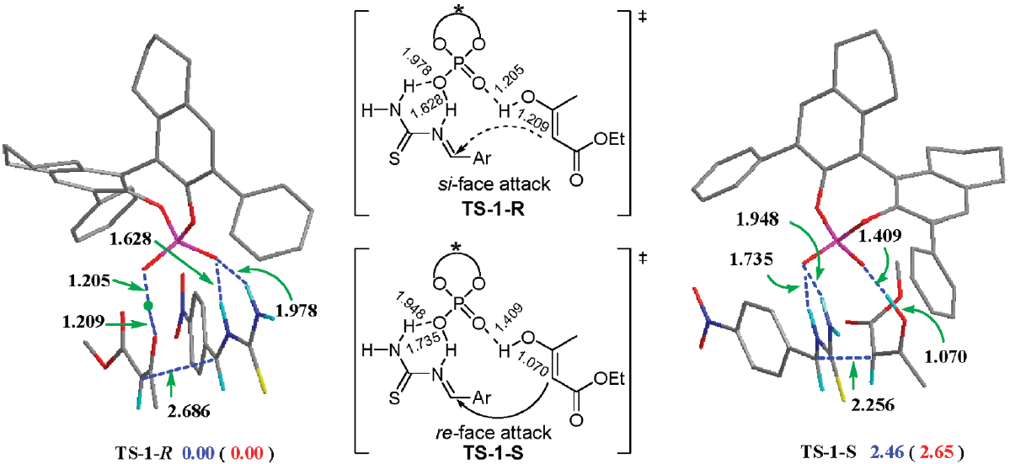
[H₈]-PA 10
Located transition state structures with distance parameters in angstroms and relative energies in enthalpy and free Energy in parentheses.

Slide 56
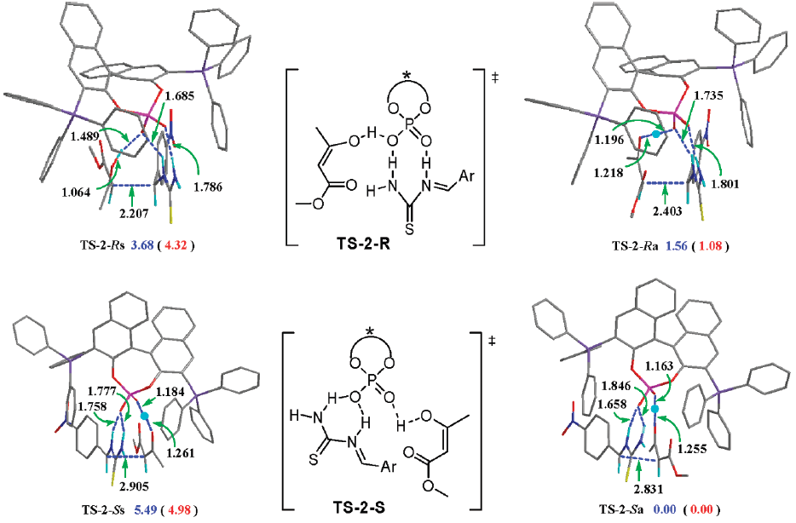
PA 2
Located transition state structures with distance parameters in angstroms and relative energies in enthalpy and free Energy in parentheses.

Slide 57
NTA 3
Proposed mechanism of Brønsted acid catalyzed asymmetric
protonations of silyl enol ethers
Yamamoto, H. et al. J. Am.Chem.Soc. 2008, 130, 9246.

